Slide 1
Empower Innovations: Powering the Future
Maxwell Reed

Slide 2
Our Story
Welcome to FuturaPower Innovations, a cutting-edge technology company that's dedicated to powering the future. Our mission is to develop innovative solutions that harness the power of technology to drive progress and make the world a better place.

Slide 3
Solutions We Provide
Innovative Technology
Positive Impact
Our products are built on the latest technologies and engineered to be both efficient and sustainable.
We're committed to making a positive impact on the world by developing products and services.
Sustainable Solutions
Expert Team
Our focus on renewable energy and smart city solutions is part of our broader commitment to creating a more sustainable future.
Our team of experienced professionals includes engineers, developers, and business leaders who are passionate about innovation and making a difference in the world.

Slide 4
Our Value Proposition
Sustainable and Efficient: Our products are built on the latest sustainable technologies, and are designed to be highly efficient.
Cost-Effective: Our products are engineered to be cost-effective, allowing our customers to save money on their energy bills over the long term.
Reliable and Durable: Our products are built to last, with high-quality components that are engineered for durability and performance.

Slide 5
Introduction to Our Company

Slide 6



Sales and Marketing Approach
Product Sales
Service Contracts
Partnerships and Joint Ventures
We generate revenue through the sale of our innovative and sustainable products, such as solar panels, wind turbines, energy storage systems.
In addition to product sales, we also generate revenue through service contracts. Our team of experienced professionals provides a range of services.
We believe in the power of collaboration, and we're constantly seeking partnerships and joint ventures with other companies.

Slide 7
Market Size and Growth
Growing Demand for Sustainable Solutions
Increasing Government Support
As the world becomes more aware of the urgent need to address climate change, there is growing demand for sustainable energy solutions.
Governments around the world are increasingly offering incentives and tax credits to individuals and businesses that adopt renewable energy and smart city solutions.

Slide 8
Competing Companies
SolarCity
General Electric
SolarCity is a well-known solar energy company that offers a range of products and services similar to those offered by FuturaPower Innovations.
However, we differentiate ourselves by offering a wider range of products and services
General Electric is a large conglomerate with a diverse range of products and services, including renewable energy solutions.
However, we differentiate ourselves by being a specialized and dedicated renewable energy and smart city solutions provider.

Slide 9
Market Comparison Diagram
FuturaPower
Quality
A
Price
Innovation
D
C
E
Marketing and Branding
B

Slide 10
Revenue Growth Plan
Expand our Product Line
We plan to expand our product line to offer a wider range of innovative and sustainable energy solutions to our customers.
Increase our Market Share
We plan to increase our market share by expanding our sales and marketing efforts in both domestic and international markets.
Collaborate with Partners
We plan to collaborate with partners, including other energy companies and research institutions.

Slide 11
Two-Year Project Plan
Expand our Product Line
Increase our Market Share
Collaborate with Partners
Feb 2023
May 2023
Oct 2023
2023
JAN
FEB
MAR
APR
MAY
JUN
JUL
AUG
SEP
OCT
NOV
DEC
2024
JAN
FEB
MAR
APR
MAY
JUN
JUL
AUG
SEP
OCT
NOV
DEC
Expand our Geographic Reach
Continuously Monitor and Adjust Strategy
Manufacturing and Marketing
Feb 2024
July 2024
Dec 2024

Slide 12
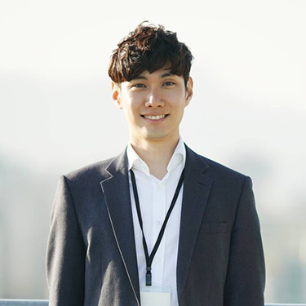



Our Team Members
David Lee
Sarah Johnso
Karen Wong
Michael Chen
CFO
CEO
CMO
COO

Slide 13
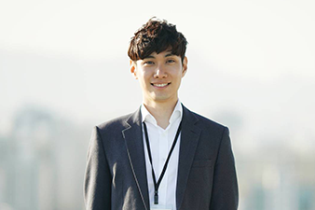



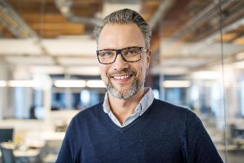



Our Team Members
Jason Brown
Emily Nguyen
Amanda Taylor
Daniel Kim
Sales Director
HR Manager
Marketing Manager
Product Manager
Samantha Patel
Brian Rodriguez
Jennifer Wong
Eric Chen
Operations Coordinator
Financial Analyst
Customer Service Manager
IT Manager

Slide 14
CONCLUSION
Overall, working for FuturaPower Innovations provides an opportunity to be part of a dynamic and innovative team that is focused on creating a sustainable future. With a strong growth strategy and a commitment to excellence, FuturaPower Innovations is poised to become a leader in the renewable energy industry.

Slide 15
THANK YOU
Jennifer Wong
205-234-4561
jenniferwong@futurapower.com
www.futurapower.com

